Slide 1
Buy Union App
Union Label & Service Trades Dept.

Slide 2
this is the first screen you see when you open the app
Main screen

Slide 3
Click here to see union-made products

Slide 4
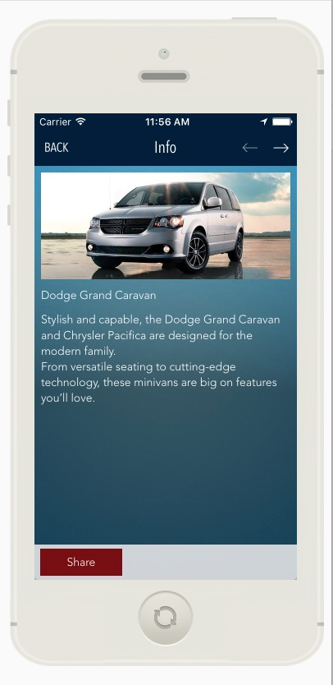
When you click on the product it will take you to a page with more information.

Slide 6
Boycott list
Don’t buy

Slide 7
Full information on the boycott

Slide 8
create a profile

Slide 9
Basic info on the department

Slide 10
twitter
social media Links

Slide 11
facebook
social media Links

Slide 12
see the latest news from the department

Slide 13
Click here to login change your settings and allow push notifications for news from the department

Slide 14
we want to help you spread the word on boycotts, rallies, strikes and more!
Push notifications
In our new app we will have the ability to reach union members via push notifications.
Push notifications can:
Alert union members when products are added to the boycott list.
Alert members when your union calls a strike or other work action against employers.
And much more.

